Slide 1
IBM University Engagement Project Submission
“Exploring the Power of Agentic AI with IBM Granite and LangFlow”

Slide 2

Project Tile – AI Powered Research Agent
Domain of Project – Education
Student Name | Recent Passport Photo | Email ID | Mobile number [WhatsApp]
Pawan narayan korde |  | pawankorde759@gmail.com | 7636958757

Slide 3
Problem Statement -
Problem Statement : Nutrition Agent
The Challenge
A Research Agent is an AI system designed to assist with academic and scientificresearch tasks. It can autonomously search for literature, summarize papers, and organize references.Using natural language processing, it understands research questions and retrieves relevant information.
The agent can generate reports, suggest hypotheses, and even draft sections of research papers.
It saves time by automating repetitive tasks like citation management and data extraction.
Research Agents enhance efficiency, accuracy, and innovation in both academic and industrial R&D.
The Objective
Build an AI-powered Research Agent that assist individuals for academic and scientific research task by summurizind lenthy
Reserch papers, can generate reports ,draft research papers .
.

Slide 4
Technology Used
Tech Stack (Mandatory)
Use any one of the following approaches:
Django
IBM watsonx.ai
Granite Models
I used django + IBM watsonx.ai + Granite Models

Slide 5
Django component Used -
1) Chat Input – Interface where users enter their queries, preferences, or meal details (text/voice/image).
2) IBM watsonx AI Agent - Processes user input using Granite models to generate personalized nutrition insights and recommendations.
3) Name of IBM Granite model - Granite-4.0-8B-Instruct → Fast, efficient for real-time diet recommendations
4) Chat output -Displays AI-generated responses such as diet plans, nutritional analysis, and health suggestions.
5) File component - Stores and retrieves user data, meal logs, and nutritional datasets for analysis and tracking.
6) Add name of any other component used.

Slide 6
Technology Used
Django -For designing frontend and backend
IBM Grainte model - for eg – ibm-granite-3-2-8b – For natural language understanding, reasoning, and personalization
IBM Cloud – It provides the infrastructure to build, deploy, and scale the Research Agent efficiently. IBM Cloud enables a reliable, secure, and scalable environment for deploying the Research Agent.
RAG– RAG to fetch real data first, then generate intelligent answers, making the Research Agent more trustworthy and effective.
IBM Watsonx.ai - For model deployment, embeddings, and AI governance

Slide 7
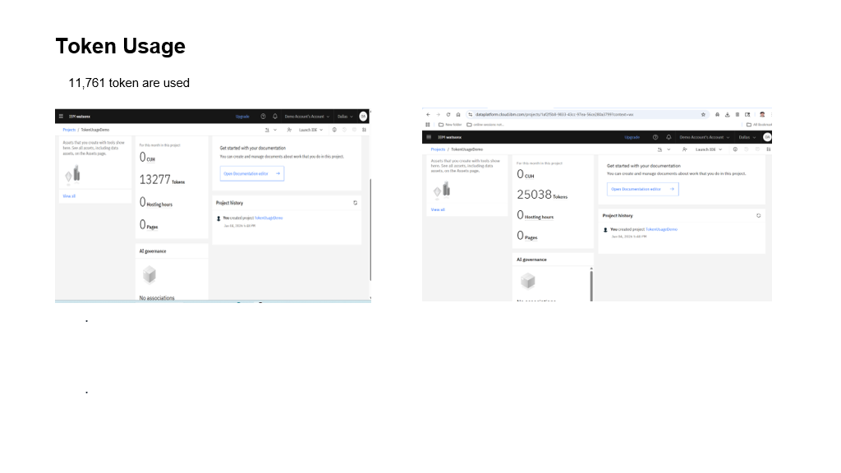

Slide 8
Novelty and Uniqueness
The proposed Nutrition Agent stands out by combining Agentic AI, RAG, and personalization into a single intelligent system.
Multi-Agent Intelligence – Instead of a single chatbot, multiple specialized agents collaborate to deliver accurate and context-aware research guidance.
RAG-Based Accuracy – Integrates real-time data retrieval with AI generation, reducing misinformation and ensuring trustworthy recommendations.
Scalable & Enterprise-Ready – Built on IBM watsonx.ai with IBM Granite models, ensuring reliability and governance.
This makes the solution a smart, adaptive, and proactive digital research agent.

Slide 9
Git Hub Link
Github URL –https://github.com/kordepawan66-ctrl/Research_agent-
Make sure you have Uploaded following three files into your github repository
1) app.json file , 2) yourproblemstatement.pdf file 3) your projectpresntation.pptx file 4)any other files
·
·
·

Slide 10


